Slide 1
Space Law Fundamentals
20 January 2023
Christopher D. Johnson
Space Law Advisor
Secure World Foundation
Professor of Law (Adjunct)
Georgetown University Law Center

Slide 2
Overview of this presentation:
This presentation will give an overview of and salient highlights of the international legal regime governing activities in outer space, as found in the 1967 Outer Space Treaty.
It will also highlight the most important and relevant United Nations fora on discussions and deliberations on space, such as the UN
Committee on the Peaceful Uses of Outer Space (COPUOS).

Slide 3
Part 1

Slide 4
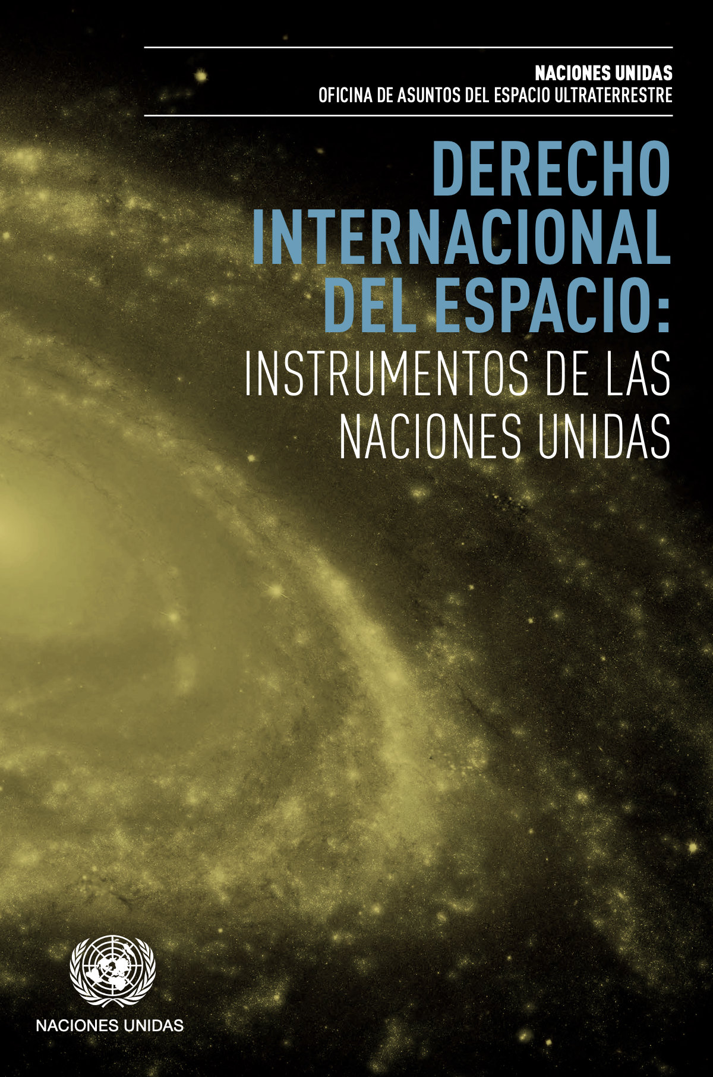
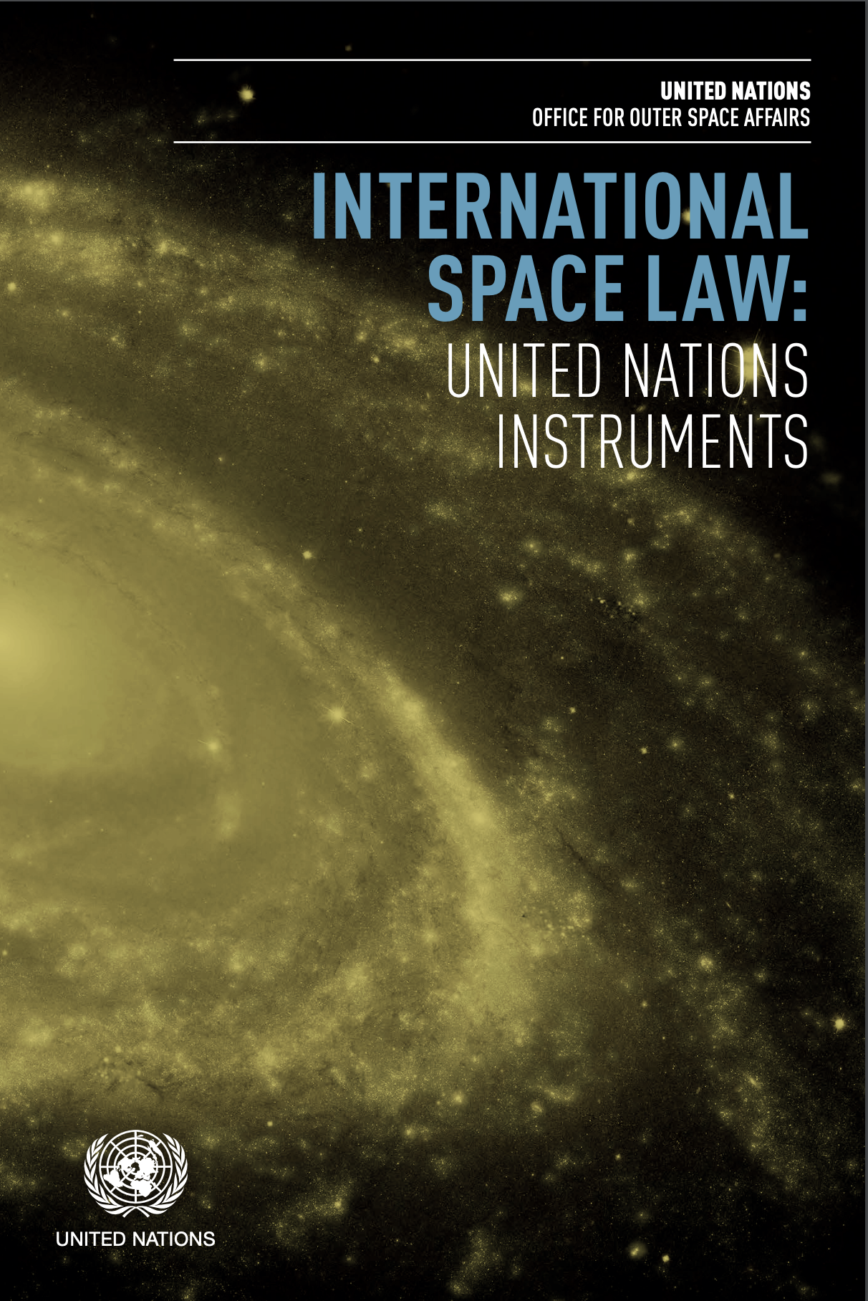
International Space Law
Treaty booklets available in all UN languages at
https://www.unoosa.org/oosa/oosadoc/data/documents/2017/stspace/stspace61rev.2_0.html

Slide 5
1967 Outer Space Treaty
The most important source of international space law.
As of 2023, 112 States are party to the Outer Space Treaty.
23 States have signed (but not yet ratified) the Outer Space Treaty.
All of the major, historical space powers, middle space powers, and emerging space powers are party to the Outer Space Treaty.
Treaty booklets available in all UN languages at
https://www.unoosa.org/oosa/oosadoc/data/documents/2017/stspace/stspace61rev.2_0.html

Slide 6
Principal Elements of the
1967 Outer Space Treaty
Art. 1 – Freedom of exploration and use
Art. 2 – Principle of non-appropriation
Art. 3 – Applicability of international law to space
Art. 4 – Non-weaponization of outer space
Art. 5 – Treatment of astronauts
Art. 6 – International responsibility
Art. 7 – International liability
Art. 8 – Jurisdiction & control
Art. 9 – Cooperation & mutual assistance; due regard

Slide 7
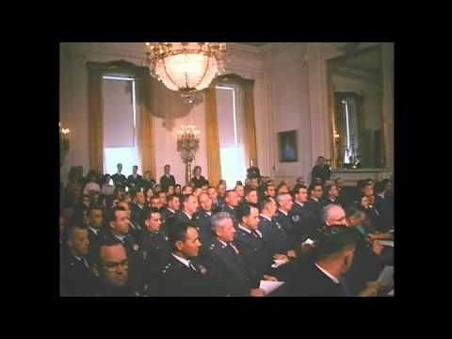
Newsreels on the
signing of the
Outer Space Treaty
LBJ Presidential Library:
https://youtu.be/ncphbeoPJ8I
Notes:
https://www.youtube.com/watch?v=gF5OZ7nANTI&t=1555s

Slide 8
Article
One
Freedom of Exploration and Use

Slide 9
The exploration and use of outer space, including the Moon and other celestial bodies, shall be carried out for the benefit and in the interests of all countries, irrespective of their degree of economic or scientific development, and shall be the province of all mankind.
Article One
Sentence 1
*FYI: All highlighting and underlining are mine.

Slide 10
Outer space, including the Moon and other celestial bodies, shall be free for exploration and use by all States without discrimination of any kind, on a basis of equality and in accordance with international law, and there shall be free access to all areas of celestial bodies.
Article One
Sentence 2

Slide 11
There shall be freedom of scientific investigation in outer space, including the Moon and other celestial bodies, and States shall facilitate and encourage international cooperation in such investigation.
Article One
Sentence 3

Slide 12
Article
Two
Principle of Non-Appropriation

Slide 13
Outer space, including the Moon and other celestial bodies, is not subject to national appropriation by claim of sovereignty, by means of use or occupation, or by any other means.
Article Two

Slide 14
Article
Three
Applicability of International Law to Space

Slide 15
States Parties to the Treaty shall carry on activities in the exploration and use of outer space, including the Moon and other celestial bodies, in accordance with international law, including the Charter of the United Nations, in the interest of maintaining international peace and security and promoting international cooperation and understanding.
Article Three

Slide 16
Article
Four
Non-Weaponization of Outer Space

Slide 17
States Parties to the Treaty undertake not to place in orbit around the Earth any objects carrying nuclear weapons or any other kinds of weapons of mass destruction, install such weapons on celestial bodies, or station such weapons in outer space in any other manner.
Article Four
Paragraph 1

Slide 18
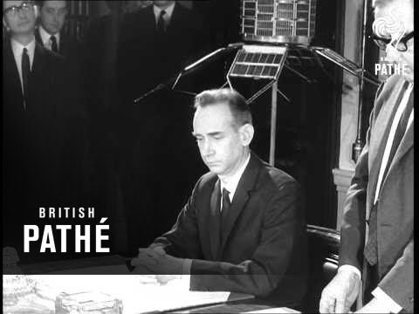
Notes:
https://youtu.be/ncphbeoPJ8I

Slide 19
The Moon and other celestial bodies shall be used by all States Parties to the Treaty exclusively for peaceful purposes.
Article Four
Paragraph 2
Sentence 1

Slide 20
The establishment of military bases, installations and fortifications, the testing of any type of weapons and the conduct of military manoeuvres on celestial bodies shall be forbidden.
Article Four
Paragraph 2
Sentence 2

Slide 21
The use of military personnel for scientific research or for any other peaceful purposes shall not be prohibited.
Article Four
Paragraph 2
Sentence 3

Slide 22
The use of any equipment or facility necessary for peaceful exploration of the Moon and other celestial bodies shall also not be prohibited.
Article Four
Paragraph 2
Sentence 4

Slide 23
Article
Five
Treatment of Astronauts

Slide 24
States Parties to the Treaty shall regard astronauts as envoys of mankind in outer space and shall render to them all possible assistance in the event of accident, distress, or emergency landing on the territory of another State Party or on the high seas.
When astronauts make such a landing, they shall be safely and promptly returned to the State of registry of their space vehicle.
Article Five
Paragraph 1

Slide 25
In carrying on activities in outer space and on celestial bodies, the astronauts of one State Party shall render all possible assistance to the astronauts of other States Parties.
Article Five
Paragraph 2

Slide 26
States Parties to the Treaty shall immediately inform the other States Parties to the Treaty or the Secretary-General of the United Nations of any phenomena they discover in outer space, including the Moon and other celestial bodies, which could constitute a danger to the life or health of astronauts.
Article Five
Paragraph 3

Slide 27
Article
Six
International Responsibility

Slide 28
Article 6
Sentence 1
States Parties to the Treaty shall bear international responsibility for national activities in outer space, including the Moon and other celestial bodies, whether such activities are carried on by governmental agencies or by non-governmental entities, and for assuring that national activities are carried out in conformity with the provisions set forth in the present Treaty.

Slide 29
Article 6
Sentence 2
The activities of non-governmental entities in outer space, including the Moon and other celestial bodies, shall require authorization and continuing supervision by the appropriate State Party to the Treaty.

Slide 30
Article 6
Sentence 3
When activities are carried on in outer space, including the Moon and other celestial bodies, by an international organization, responsibility for compliance with this Treaty shall be borne both by the international organization and by the States Parties to the Treaty participating in such organization.

Slide 31
Article
Seven
International Liability

Slide 32
Each State Party to the Treaty that launches or procures the launching of an object into outer space, including the Moon and other celestial bodies, and each State Party from whose territory or facility an object is launched, is internationally liable for damage to another State Party to the Treaty or to its natural or juridical persons by such object or its component parts on the Earth, in air space or in outer space, including the Moon and other celestial bodies.
Article 7

Slide 33
Article
Eight
Jurisdiction and Control

Slide 34
A State Party to the Treaty on whose registry an object launched into outer space is carried shall retain jurisdiction and control over such object, and over any personnel thereof, while in outer space or on a celestial body.
Article 8
Sentence 1

Slide 35
Ownership of objects launched into outer space, including objects landed or constructed on a celestial body, and of their component parts, is not affected by their presence in outer space or on a celestial body or by their return to the Earth.
Article 8
Sentence 2

Slide 36
Such objects or component parts found beyond the limits of the State Party to the Treaty on whose registry they are carried shall be returned to that State Party, which shall, upon request, furnish identifying data prior to their return.
Article 8
Sentence 3

Slide 37
Article
Nine
Cooperation, Mutual Assistance, Due Regard

Slide 38
In the exploration and use of outer space, including the Moon and other celestial bodies, States Parties to the Treaty shall be guided by the principle of cooperation and mutual assistance and shall conduct all their activities in outer space, including the Moon and other celestial bodies, with due regard to the corresponding interests of all other States Parties to the Treaty.
Article 9
Sentence 1

Slide 39
States Parties to the Treaty shall pursue studies of outer space, including the Moon and other celestial bodies, and conduct exploration of them so as to avoid their harmful contamination and also adverse changes in the environment of the Earth resulting from the introduction of extraterrestrial matter and, where necessary, shall adopt appropriate measures for this purpose.
Article 9
Sentence 2

Slide 40
If a State Party to the Treaty has reason to believe that an activity or experiment planned by it or its nationals in outer space, including the Moon and other celestial bodies, would cause potentially harmful interference with activities of other States Parties in the peaceful exploration and use of outer space, including the Moon and other celestial bodies, it shall undertake appropriate international consultations before proceeding with any such activity or experiment.
Article 9
Sentence 3

Slide 41
A State Party to the Treaty which has reason to believe that an activity or experiment planned by another State Party in outer space, including the Moon and other celestial bodies, would cause potentially harmful interference with activities in the peaceful exploration and use of outer space, including the Moon and other celestial bodies, may request consultation concerning the activity or experiment.
Article 9
Sentence 4

Slide 42
Articles
10 - 17

Slide 43
I don’t really teach these later articles in the Treaty.
You can read them for yourself.
The later articles are mostly operational formalities about treaty status, amendments, withdrawal, etc.
Articles 10-17

Slide 44
Article
12

Slide 45
All stations, installations, equipment and space vehicles on the Moon and other celestial bodies shall be open to representatives of other States Parties to the Treaty on a basis of reciprocity.
Such representatives shall give reasonable advance notice of a projected visit, in order that appropriate consultations may be held and that maximum precautions may be taken to assure safety and to avoid interference with normal operations in the facility to be visited.
Article 12

Slide 46
The United Nations
Committee On the
Peaceful Uses of Outer
Space (COPUOS)

Slide 47
United Nations System
Six principal organs of the United Nations (in no particular order) [UN Charter, Article 7.1]:
The General Assembly (UNGA)
The Security Council (the Permanent 5 are China, France, Russia, UK & USA)*
The Economic and Social Council (ECOSOC)
The Trusteeship Council (suspended in 1994)
The International Court of Justice (ICJ)
The Secretariat
*There are 10 Non-permanent Security Council members (& year their term ends):
Albania (2023) Brazil (2023) Gabon (2023) Ghana (2023) India (2022) Ireland (2022)
Kenya (2022) Mexico (2022) Norway (2022) United Arab Emirates (2023)

Slide 48
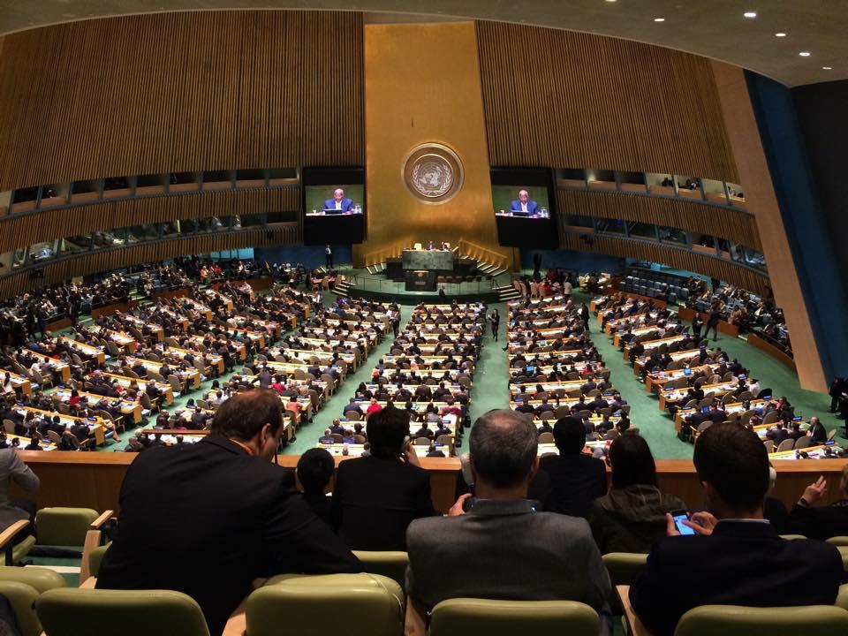
United Nations General Assembly

Slide 49
COPUOS in the United Nations System
Main Committees to the United Nations General Assembly (UNGA)
The First Committee Disarmament and International Security
The Second Committee Economic and Financial
The Third Committee Social, Cultural, and Humanitarian
The Fourth Committee Special Political and Decolonization
The Fifth Committee Administrative and Budgetary
The Sixth Committee Legal
+ Procedural Committees, and Standing Committees
The Special Political and Decolonization Committee deals with a variety of subjects which include those related to decolonization, Palestinian refugees and human rights, peacekeeping, mine action, outer space, public information, atomic radiation and University for Peace.
COPUOS reports to the Special Political and Decolonization Committee (4th Committee).
Meanwhile, the UN Conference on Disarmament (CD) reports to the Disarmament and International Security Committee (1st Committee). However, the CD has been deadlocked for almost 20 years.

Slide 50
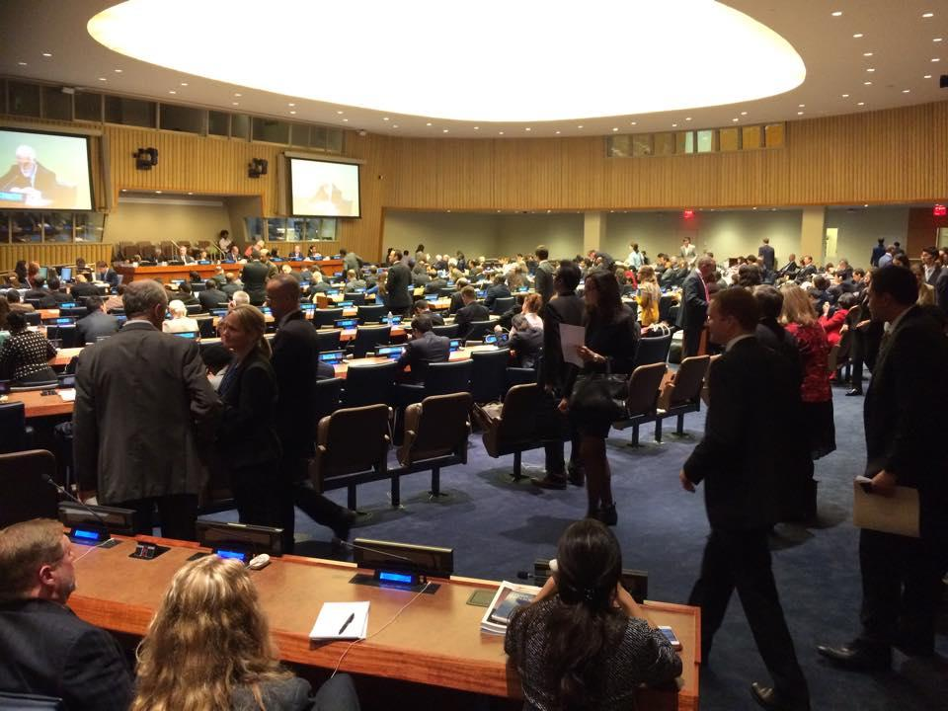
UNGA First Committee

Slide 51
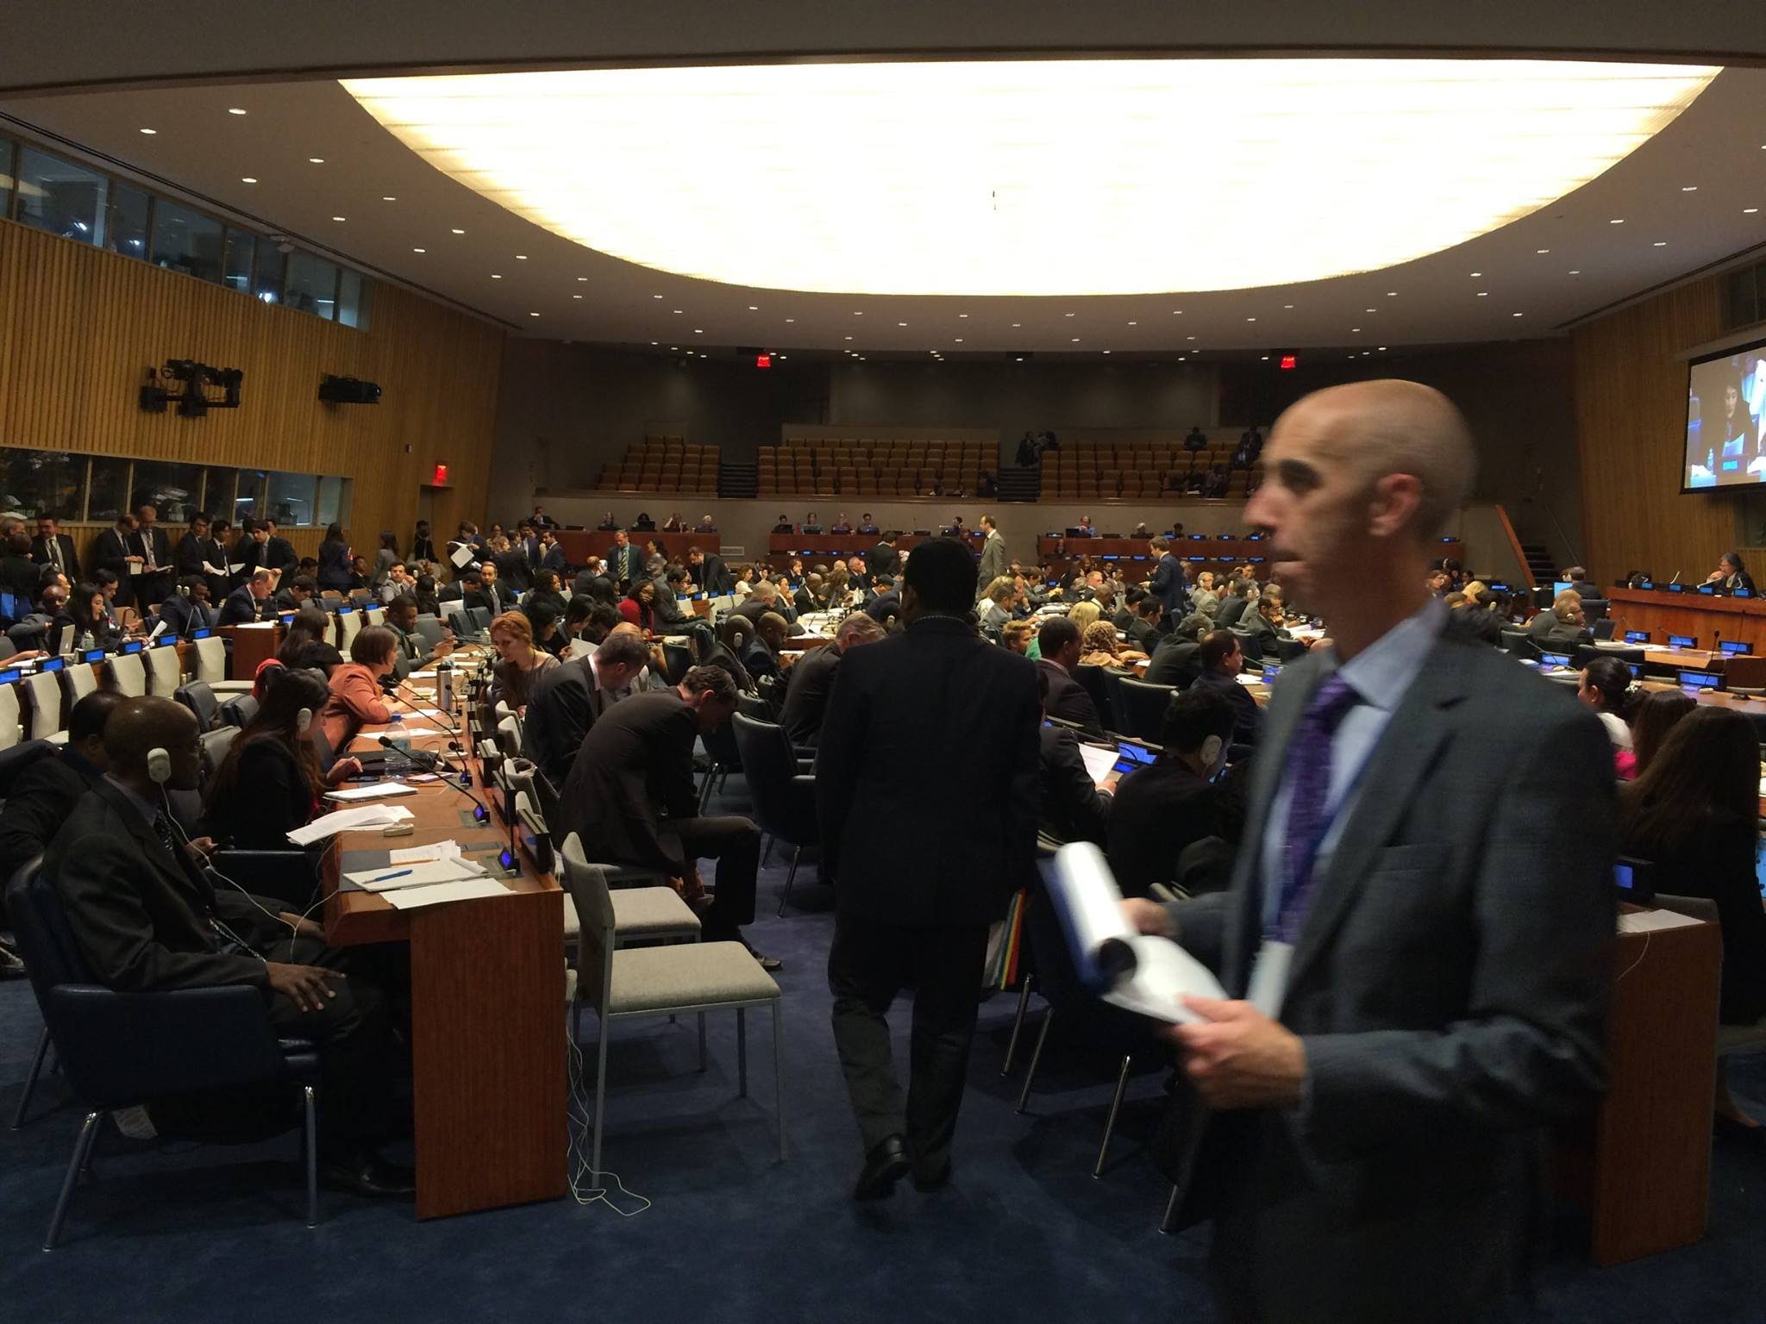
UNGA First Committee

Slide 52
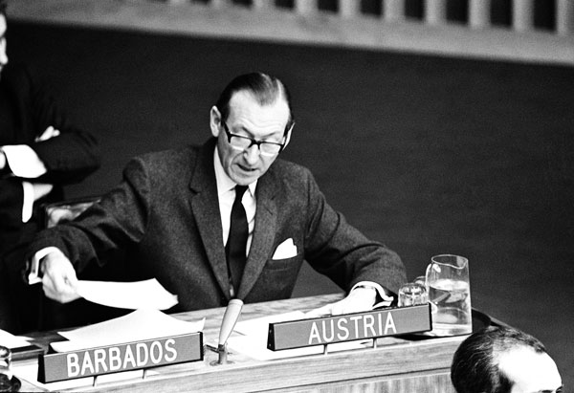
17 December 1966
Mr. Kurt Waldheim (Austria)
addressing the Committee
on the Draft Outer Space Treaty.
UNGA First Committee
United Nations, New York.
Source: United Nations Audiovisual Library of International Law. http://legal.un.org/avl/ha/lawofouterspace.html

Slide 53
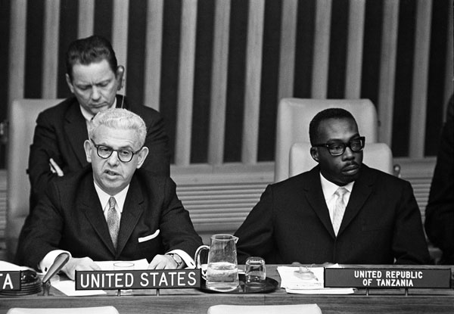
17 December 1966
UN General Assembly First Committee.
Arthur J. Goldberg (USA) (left) and E. E. Seaton
(Tanzania) (right) addressing the Committee on
the Draft Outer Space Treaty
United Nations, New York.

Slide 54
History of COPUOS and Space Law
 | Instrument
1958 | UNGA Res. 1348 (XIII) COPUOS ad hoc committee
1959 | UNGA Res. 1472 (XIV) COPUOS permanent committee
1961 | UNGA Res. 1721 (XVI) International Cooperation Resolution
1963 | UNGA Res. 1962 (XVIII) Legal Principles Declaration
1967 | Outer Space Treaty
1968 | Rescue Agreement
1972 | Liability Convention
1975 | Registration Convention
1979 | Moon Agreement
1982 | UNGA Res. 37/92 Direct Broadcasting Principles
1986 | UNGA Res. 41/65 Remote Sensing Principles
1992 | UNGA Res. 47/68 Nuclear Power Sources Principles
1996 | UNGA Res. 51/122 International Cooperation Declaration
2007 | UNGA Res. 62/217 Space Debris Mitigation Guidelines
2009 | Nuclear Power Sources Safety Framework
2019 | Long-term Sustainability Guidelines

Slide 55
COPUOS Members and Observers
1959: 24 Member States
2022: 100 Member States
Albania, Algeria, Angola, Argentina, Armenia, Australia, Austria, Azerbaijan, Bahrain, Bangladesh, Belarus, Belgium, Benin, Bolivia, Brazil, Bulgaria, Burkina Faso, Cameroon, Canada, Chad, Chile, China, Colombia, Costa Rica, Cuba, Cyprus, Czech Republic, Denmark, Dominican Republic, Ecuador, Egypt, El Salvador, Ethiopia, Finland, France, Germany, Ghana, Greece, Hungary, India, Indonesia, Iran, Iraq, Israel, Italy, Japan, Jordan, Kazakhstan, Kenya, Kuwait, Lebanon, Libya, Luxembourg, Malaysia, Mauritius, Mexico, Mongolia, Morocco, Netherlands, New Zealand, Nicaragua, Niger, Nigeria, Norway, Oman, Pakistan, Panama, Paraguay, Peru, Philippines, Poland, Portugal, Qatar, Republic of Korea, Romania, Russian Federation, Rwanda, Saudi Arabia, Senegal, Sierra Leone, Singapore, Slovakia, Slovenia, South Africa, Spain, Sri Lanka, Sudan, Sweden, Switzerland, Syrian Arab Republic, Thailand, Tunisia, Turkey, Ukraine, United Arab Emirates, United Kingdom of Great Britain and Northern Ireland, United States of America, Uruguay, Venezuela & Viet Nam
https://www.unoosa.org/oosa/en/ourwork/copuos/members/evolution.html

Slide 56
COPUOS Members and Observers
International Intergovernmental and Non-Governmental Observers
AARSE: African Association of Remote Sensing of the Environment; AOCRS: African Organization of Cartography and Remote Sensing; APSCO: The Asia-Pacific Space Cooperation Organization; ARSCAW: Association of Remote Sensing Centres in the Arab World; ASE: Association of Space Explorers; CANEUS-International; CEOS: Committee on Earth Observation Satellites; COSPAR: Committee on Space Research; CRTEAN: Centre Regional de teledetection des Etats de l'Afrique duNord; ESA: European Space Agency; ESF: European Science Foundation, represented by the European Space Sciences Committee; ESO: European Organisation for Astronomical Research in the Southern Hemisphere; ESPI: European Space Policy Institute; EU: European Union; EURISY: European Association for the International Space Year; EUTELSAT-IGO: European Telecommunications Satellite Organization; For All Moonkind; IAA: International Academy of Astronautics; IAASS: International Association for the Advancement of Space Safety; IATA: International Air Transport Association; IAU: International Astronomical Union; Ibero-American Institute of Aeronautic and Space Law and Commercial Aviation; IIASA: International Institute for Applied Systems Analysis; IISL: International Institute of Space Law; ILA: International Law Association; IMSO: International Mobile Satellite Organization; International Astronautical Federation; International Institute for the Unification of Private Law (UNIDROIT); INTERSPUTNIK: International Organization of Space Communications; ISNET: Inter Islamic Network on Space Sciences and Technology; ISO: International Organization of Standardization; ISPRS: International Society for Photogrammetry and Remote Sensing; ISU: International Space University; ITSO: International Telecommunication Satellite Organization; Moon Village Association; NSS: National Space Society; Open Lunar Foundation; PSIPW: Prince Sultan Bin Abdulaziz International Prize for Water; SCOSTEP: Scientific Committee on Solar-Terrestrial Physics;SGAC: Space Generation Advisory Council: Square Kilometre Array Observatory; SWF: Secure World Foundation; TPS: The Planetary Society; UNISEC-Global: University Space Engineering Consortium-Global; WSWA: World Space Week Association

Slide 57
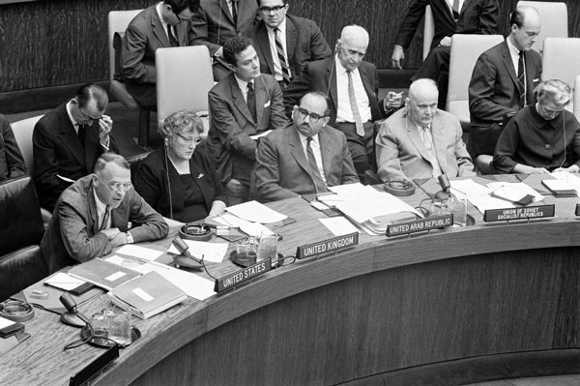
10 September 1962
Second Session of COPUOS
(first row, left to right):
Ambassador T. P. Plimpton (USA), speaking
Miss. J.A.C. Gutteridge (UK)
Mr. El Sayed Raouf El Reedy (United Arab Republic)
Ambassador Platon Morozov (USSR).

Slide 58
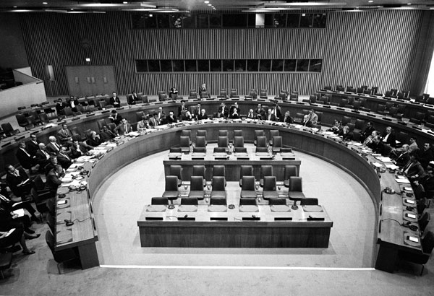
9 September 1963 Fourth Session of COPUOS
United Nations, New York.

Slide 59
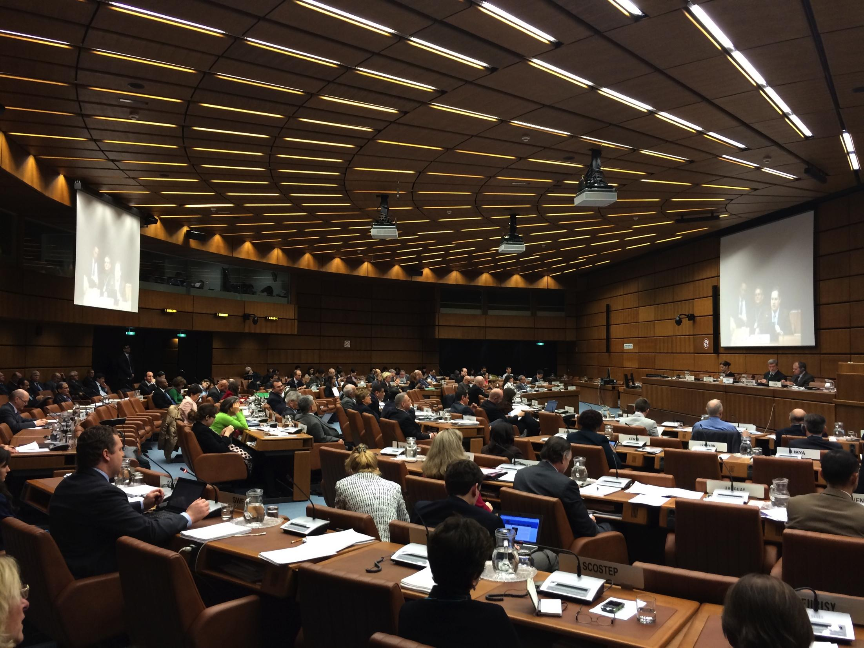
2014 Scientific and Technical Subcommittee

Slide 60
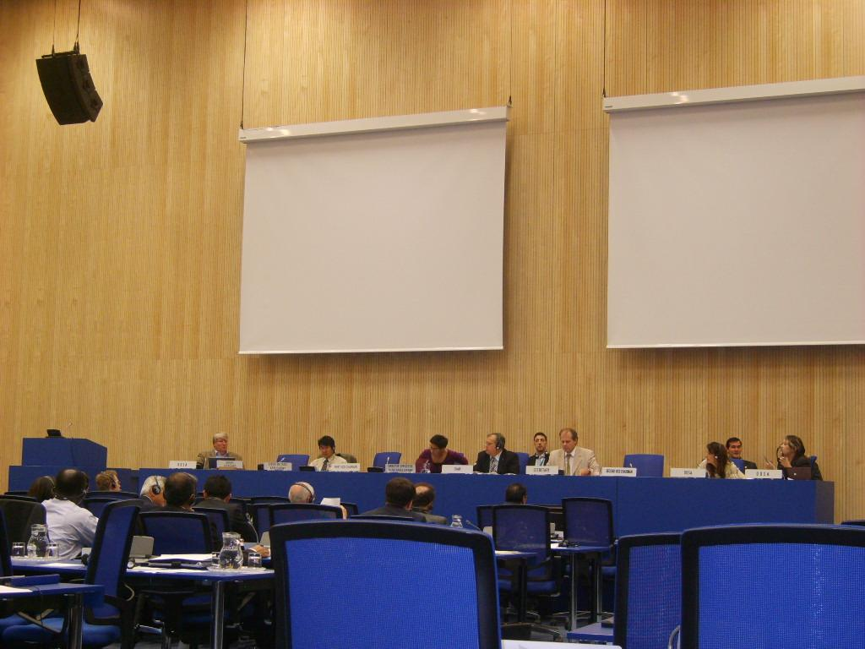
2010 COPUOS in the UN Vienna “M” Building,
normally used by the International Atomic Energy Agency (IAEA)

Slide 61
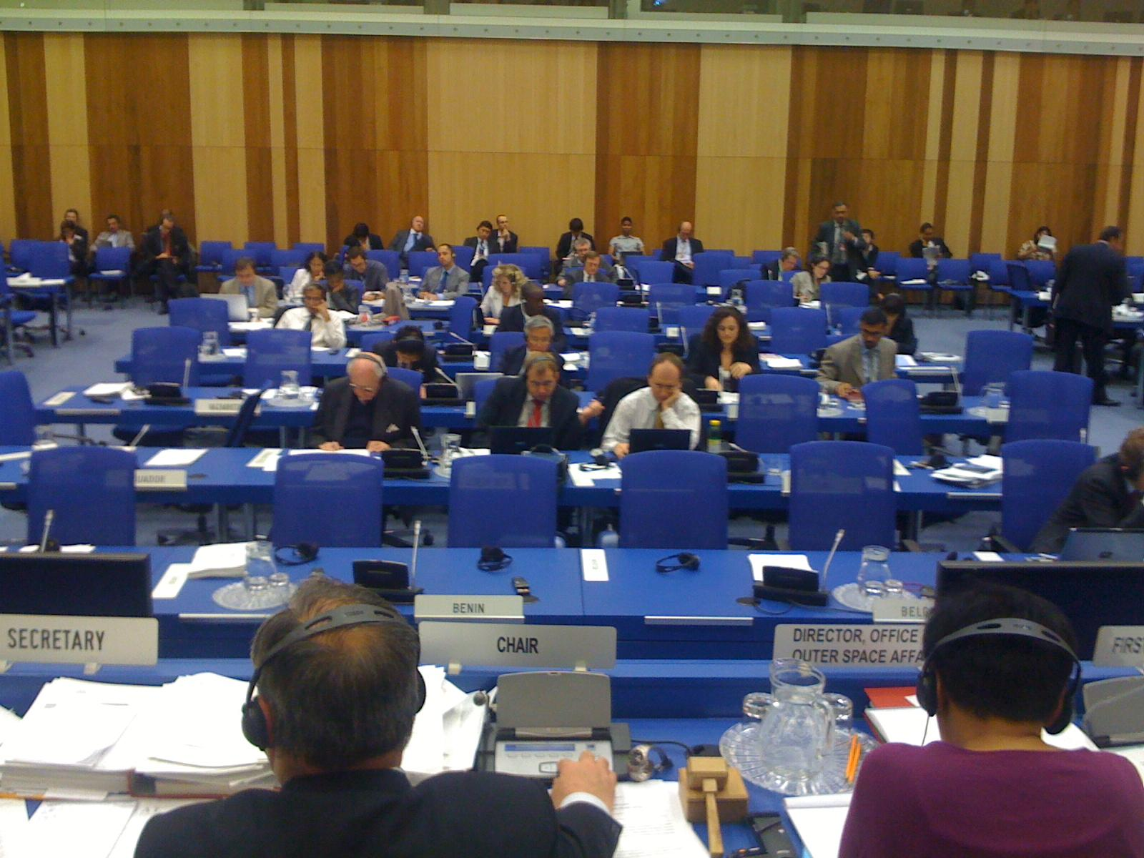
2010 COPUOS in the UN Vienna “M” Building,
normally used by the International Atomic Energy Agency (IAEA)

Slide 62
2023 COPUOS Schedule
 | Date | Location
60th Scientific and Technical Subcommittee | February 6–17, 2023 | Vienna
62nd Legal Subcommittee | March 20–31, 2023 | Vienna
66th Committee on the Peaceful Uses of Outer Space | May 31 – June 9, 2023 | Vienna
2023 Schedule of work of the Committee and its subsidiary bodies

Slide 63
Agenda of the
Scientific and Technical Subcommittee
2023 Agenda Items at the STSC
Adoption of the agenda.
Election of the Chair.
Statement by the Chair.
General exchange of views and introduction of reports submitted on national activities.
United Nations Programme on Space Applications.
Space technology for sustainable socioeconomic development.
Matters relating to remote sensing of the Earth by satellite, including applications for developing countries and monitoring of the Earth’s environment.
Space debris.
Space-system-based disaster management support.
Recent developments in global navigation satellite systems.

Slide 64
Agenda of the
Scientific and Technical Subcommittee
2023 Agenda Items at the STSC
Space weather.
Near-Earth objects.
Long-term sustainability of outer space activities.
Future role and method of work of the Committee.
Use of nuclear power sources in outer space.
Space and global health.
Examination of the physical nature and technical attributes of the geostationary orbit and its utilization and applications, including in the field of space communications, as well as other questions relating to developments in space communications, taking particular account of the needs and interests of developing countries, without prejudice to the role of the International Telecommunication Union.
Draft provisional agenda for the sixtieth session of the Scientific and Technical Subcommittee.
Report to the Committee on the Peaceful Uses of Outer Space.

Slide 65
Working Groups of the
Scientific and Technical Subcommittee
Working Group of the Whole
Working Group on the Use of Nuclear Power Sources in Outer Space
Working Group on the Space and Global Health
Working Group on the Long Term Sustainability of Outer Space Activities
More at: https://www.unoosa.org/oosa/en/ourwork/copuos/working-groups.html

Slide 66
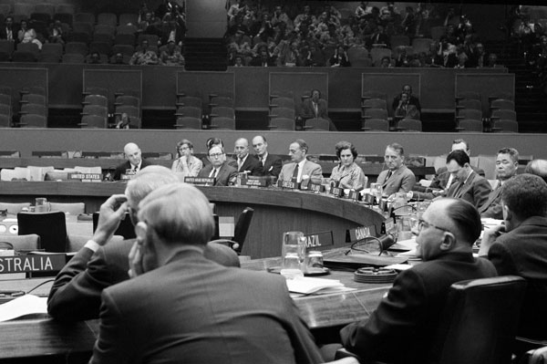
26 May 1959
First Session of the Legal Subcommittee. United Nations, New York.

Slide 67
Agenda of the Legal Subcommittee
2023 Agenda Items at the Legal Subcommittee (LSC)
Adoption of the agenda.
Statement by the Chair.
General exchange of views.
Information on the activities of international intergovernmental and non-governmental organizations relating to space law.
Status and application of the five United Nations treaties on outer space.
Matters relating to:
The definition and delimitation of outer space;
The character and utilization of the geostationary orbit, including consideration of ways and means to ensure the rational and equitable use of the geostationary orbit without prejudice to the role of the International Telecommunication Union.
National legislation relevant to the peaceful exploration and use of outer space.
Capacity-building in space law.
Review and possible revision of the Principles Relevant to the Use of Nuclear Power Sources in Outer Space.
General exchange of information and views on legal mechanisms relating to space debris mitigation and remediation measures, taking into account the work of the Scientific and Technical Subcommittee.

Slide 68
Agenda of the Legal Subcommittee
2023 Agenda Items at the Legal Subcommittee (LSC)
General exchange of information on non-legally binding United Nations instruments on outer space.
General exchange of views on the legal aspects of space traffic management.
General exchange of views on the application of international law to small-satellite activities.
General exchange of views on potential legal models for activities in exploration, exploitation and utilization of space resources.
Proposals to the Committee on the Peaceful Uses of Outer Space for new items to be considered by the Legal Subcommittee at its sixtieth-second session.

Slide 69
Working Groups of the Legal Subcommittee
Working Group on the Status and Application of the Five United Nations Treaties on Outer Space.
Chair: Bernhard Schmidt-Tedd (Germany)
Working Group on the Definition and Delimitation of Outer Space
Chair: Prof. José-Monserrat Filho (Brazil) / André Rypl (Brazil)
Working Group on Potential Legal Models Potential Legal models for Activities in the Exploration, Exploitation and Utilization of Space Resources
Chair: Prof. Steven Freeland (Australia) / Andrej Miztal (Poland)

Slide 70
Annual IISL / ECSL Symposium
at the Legal Subcommittee
Symposium organized by the International Institute of Space Law (IISL)
and the European Centre for Space Law (ECSL)
National Laws and Regulations to Ensure Space Sustainability
Tuesday, 5 April 2022
https://www.unoosa.org/oosa/en/ourwork/copuos/lsc/2022/symposium.html
International Institute of Space Law
https://iislweb.org/
European Centre for Space Law
https://www.esa.int/About_Us/ECSL_European_Centre_for_Space_Law/

Slide 71
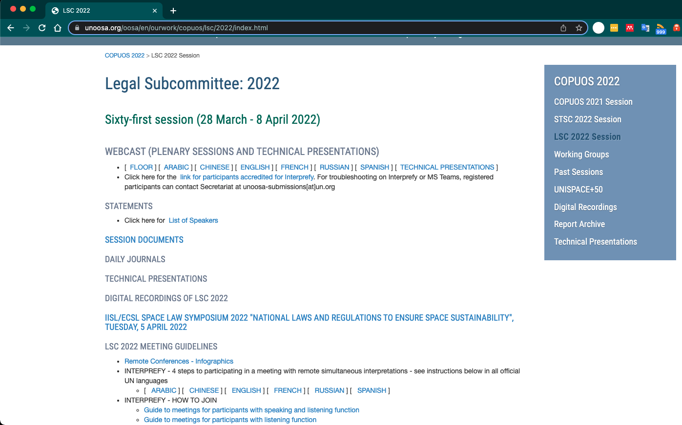
2022 Legal Subcommittee
https://www.unoosa.org/oosa/en/ourwork/copuos/lsc/2022/index.html

Slide 72
2022 COPUOS Agenda
Agenda Items for the 66th Session of COPUOS (2023)
May 31– June 9, 2023
Opening of the session.
Adoption of the agenda.
Statement by the Chair.
General exchange of views.
Ways and means of maintaining outer space for peaceful purposes.
Report of the Scientific and Technical Subcommittee on its fifty-ninth session.
Report of the Legal Subcommittee on its sixtieth-first session.
Space and sustainable development.
Spin-off benefits of space technology: review of current status.
Space and water.
Space and climate change.
Use of space technology in the United Nations system.
Future role of the Committee.
Space exploration and innovation.
“Space2030” agenda.
Other matters.
Report of the Committee to the General Assembly.

Slide 73
Thank You
Christopher Johnson
cjohnson@swfound.org

Slide 74
How many States are party to the Outer Space Treaty?
Which article in the Outer Space Treaty contained the non-appropriation principle?
List the principles contained in Article IX?
Which was first - the Registration Convention or the Liability Convention?
How many States are members of COPUOS?
List the subcommittees of COPUOS
Where else is space formally discussed at the United Nations?
Quiz to prompt your short term memory

