Slide 1

Morals: mm-wave 5G and Weather Forecasting
This presentation was prepared by the author in his personal capacity. The opinions expressed are the author’s own and do not reflect the views of any member of congress, any congressional committee, or the IEEE.
Elliot Eichen
elliot.eichen@choyu.net

Slide 2
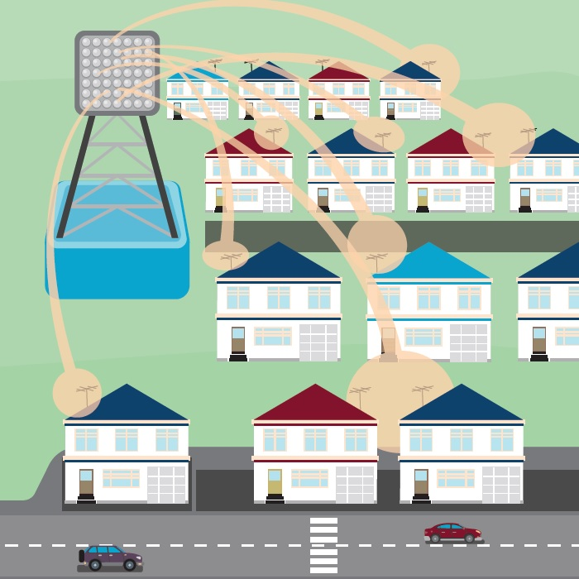
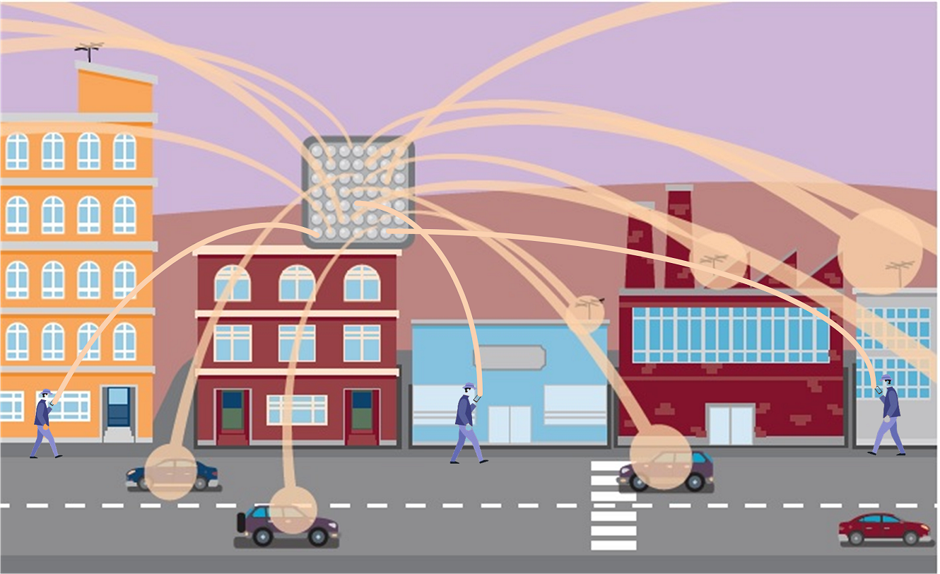
Almost everything you need to know about mm-wave 5G
mm-wave spectrum is needed for ultra-fast applications (small cells + wider channels = ultra fast). Many other 5G features (IOT, low latency, edge computing, mission critical, etc.) can also use mid/low bands.
IMO mission critical applications (e.g., autonomously driven cars) will NOT rely on mm-wave spectrum.
Industry (GSMA) proposed specific bands with desirable transmission characteristics (New Radio 2 - NR2) . Many of these bands overlap with EESS.
Residential/suburban fixed-wireless broadband
Urban fixed-wireless and mobile broadband.

Slide 3
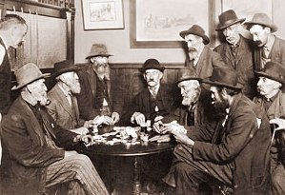
Perspective on the path to auction 102 & US current position (-28 dBW/200MHz).
Public Theatre
Interagency Conflict
Suppression of Scientific Engagement
FCC/CITEL vs. NOAA/NASA.
ALL of the FCC/CITEL public arguments against NASA/NOAA analysis were either scientifically incorrect, deliberately misleading, or red hearings. (This masked a real question per ITU methodology.)
No analysis in support of the FCC’s -20 or -28 dBW/200Mz. (Note the GSMA’s -37 dBW, & French submission => < -40 dBW normalized results across ITU submissions)
Spectrum conflicts supposed to be resolved at the IRAC.
FCC represents commercial users of spectrum, NTIA represents government users of spectrum. However, all players at the table.
IRAC unable to resolve issue. Bumped to the White House (NSC, then redirected to NEC) to support FCC/CITEL/5G.
The suppression of science in the pursuit of policy.
NASA/NOAA muzzled & prevented from releasing their analysis’ (which agree with the bulk of ITU submissions).
DOD muzzled, after releasing document “probable degradation of weather and ocean models, resulting in increased risk in Safety of Flight and Safety of Navigation.”
National Academy of Sciences muzzled.

Slide 4
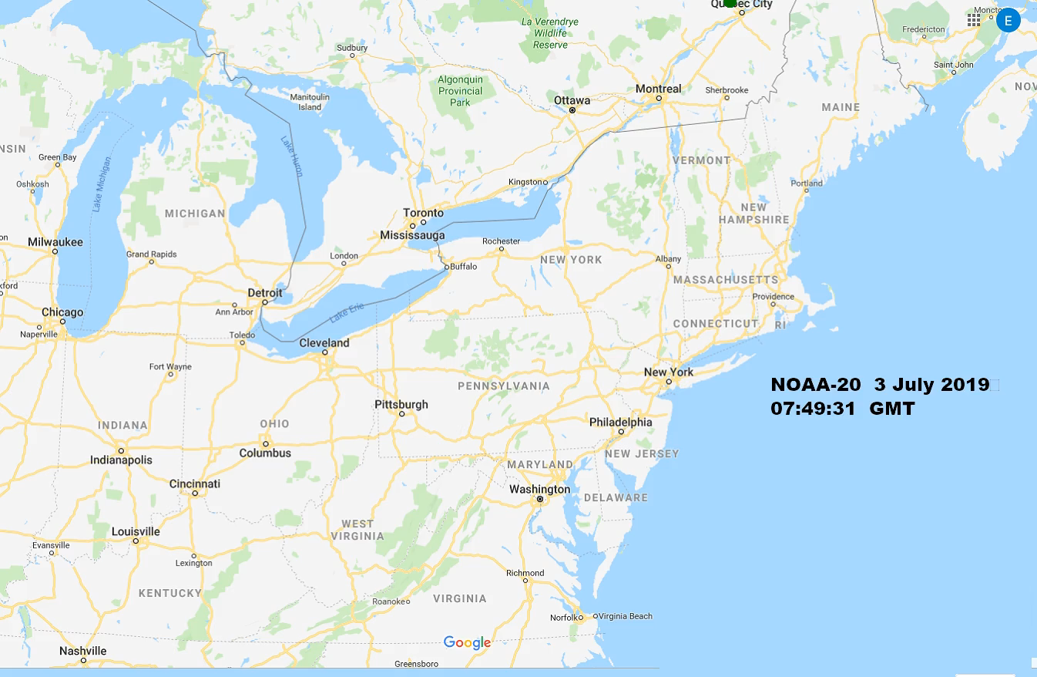
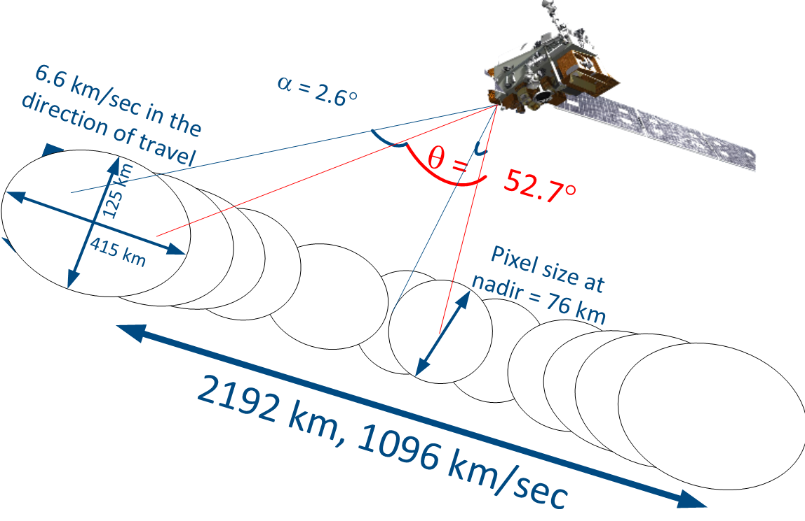
Potential Solution: Real-Time Geographical Spectrum Sharing (RGSS)
ATMS/NOAA-20
RGSS-1 (5G network read): Out-of-Band (OOB) emissions accurately calculated per satellite/instrument fly over based on real-time snapshot of 5G Radio Access Network within radiometer’s instantaneous (effective) field of view (IFOV) for each measurement pixel. (Identifies bad pixels & enables data correction).
RGSS-2 (5G network read/write): Modify 5G traffic while Base Stations and User Equipment are within the IFOV of measuring radiometer during satellite flyovers so that the OOB emissions do not corrupt data. (Synergistic with dual radio/option 3.xx 5G architectures, maintains network availability > 99.99%).

Slide 5
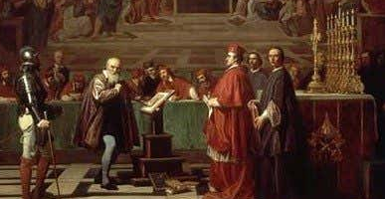
The Broader Question:
The Trial of Galileo in 1632
The Broader Question: The suppression of science in the pursuit of policy.
Does Science advise Policy, or does Politics dictate to Science?
What can you do about it?
  Advocacy for science and rational/fact-base policy.
  Both the AMS and IEEE support Congressional Fellowships!

