Slide 1
Lifetime Analysis in Launch Window Maps:
Designing Satellite Orbits for Demise
Hossein Namazyfard, Dr. Aaron J. Rosengren, Dr. Davide Amato
The University of Arizona, Tucson, AZ, United States

Slide 2
Orbiting Debris: A Space Environment Problem
“Space operations should comply with a general rule of the National Park Service: What you take in, you must take out”
-Joseph P. Loftus, Jr/NASA Johnson Space Center

Slide 3
A Growing Problem
Mitigation guidelines for space debris are often ignored
  IADC 25 year guideline
  Compliance with these guidelines will become crucial in the near future
Proposed Solution:
  Passive disposal through utilization of natural dynamical instabilities
  End of life (EOL) options need to be clearly identified during early phases of mission design
  Incorporating lifetime estimates into launch window constraints
Notes:
Compliance with guidelines: Placement of proposed mega consellations that will be placed in already congested areas

Slide 4
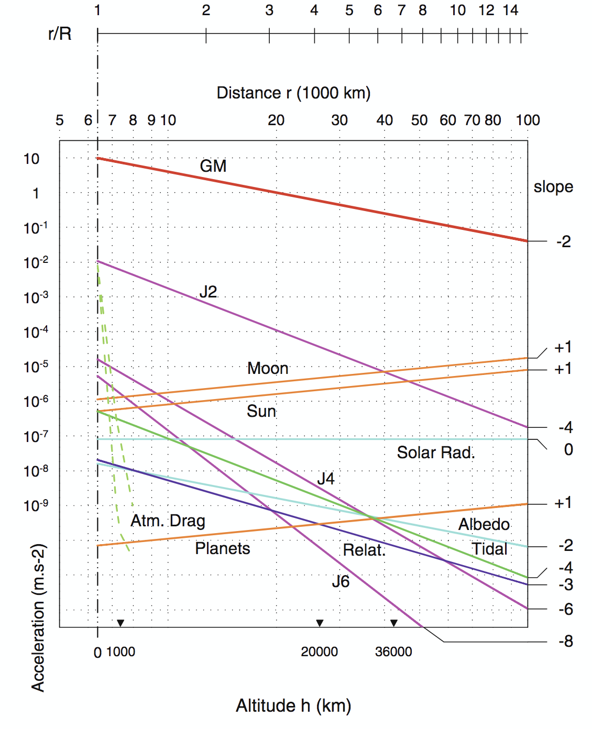
Highly-Eccentric Orbits
Long lasting LEO-GEO crossings increase probability of collisions
Large apogee distances allow for lunisolar perturbations to govern dynamics
Reentry was long thought to be dominated by atmospheric drag and J2 effects
  Not the case for HEOs!
Notes:
Govern dynamics? Or dominate dynamics?
Such short time at perigee

Slide 5
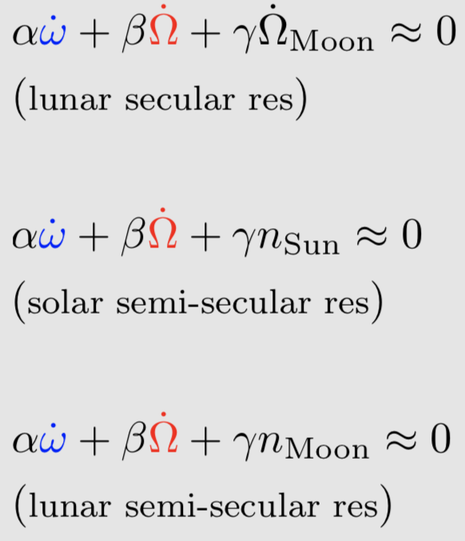
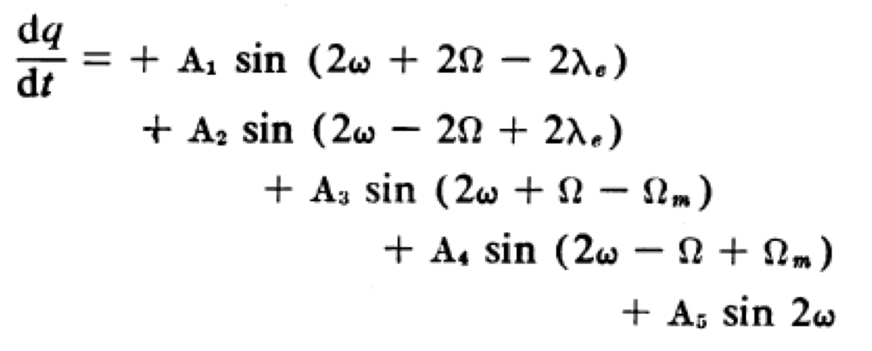
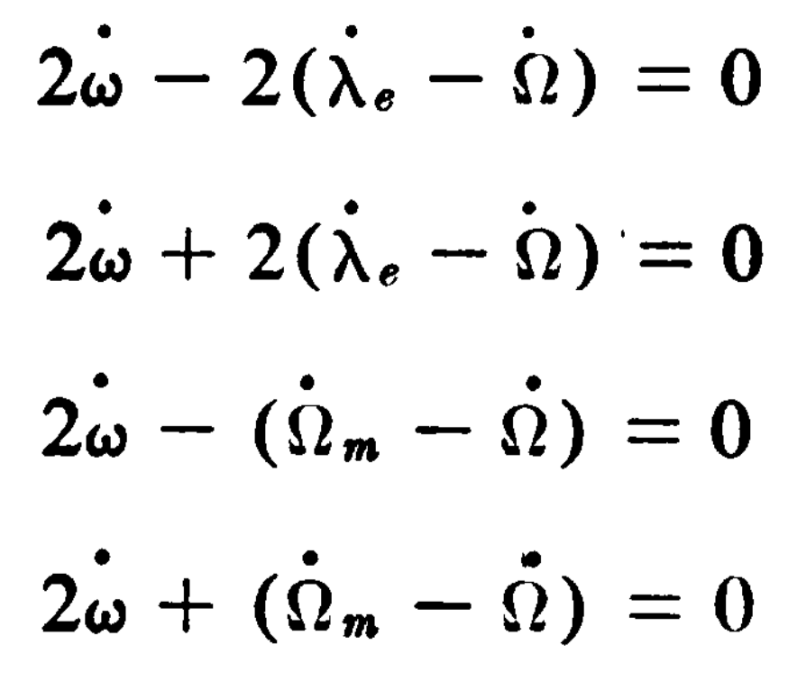
Early Lunisolar Perturbation Studies
“Solar and Lunar effects on highly eccentric satellite orbits show that the sun and the moon may cause large changes in perigee height...” (Musen et. al. 1959 Science)

Slide 6
Early Lunisolar Perturbation Studies
“The knowledge of these long-period effects is essential for determining the stability of the orbit and the lifetime of the satellite.” (Musen et. al. 1959 Science)

Slide 7
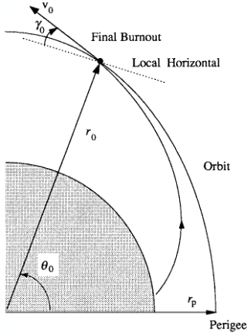
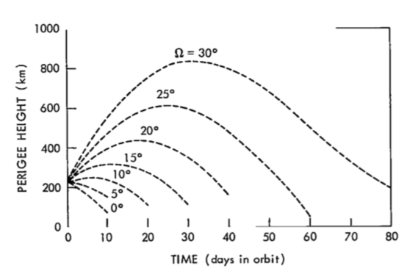
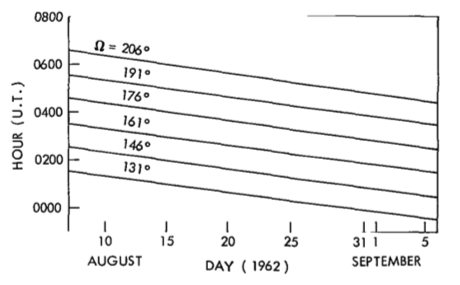
Early Lunisolar Perturbation Studies
“The lifetime of the orbit may be determined as a function of this angle [Right Ascension of Ascending Node]…the node may be converted into time of day for any given day.” (Shute 1963 AIAA)
Notes:
If all launch conditions/orbital elements are set except for RAAN, we can attain different orbits corresponding to different nodes.
Keeping all orbital elements constant we can achieve different lifetimes based on launching in different nodes
We can change the node launched into by varying the time of day ( precess 360 in 24 hours… 15 deg in an hour)
If constant node is selected the time of day to launch into that node decreases by 4 min the subsequent day

Slide 8
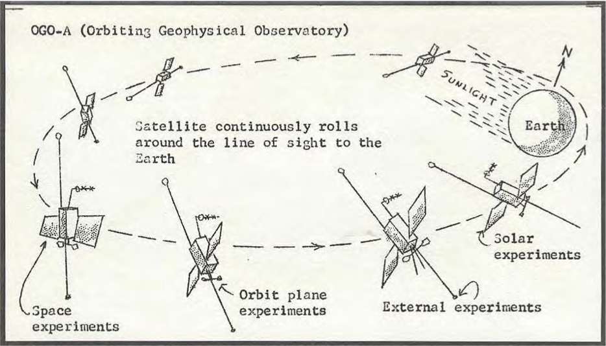
Orbiting Geophysical Observatory (OGO)
OGO 1 1964-054A Launched: 5 Sept. 1964 HEO (still in orbit)
OGO 2 1965-081A Launched: 14 Oct. 1965 POLAR (decayed 17 Sept. 1981)
OGO 3 1966-049A Launched: 7 June 1966 HEO (decayed 14 Sept. 1981)
OGO 4 1967-073A Launched: 28 July 1967 POLAR (decayed 16 Aug. 1972)
OGO 5 1968-014A Launched: 4 Mar. 1968 HEO (decayed 2 Jul. 2011)
OGO 6 1969-051A Launched: 5 June 1969 POLAR (decayed 12 Oct. 1979)

Slide 9
Orbiting Geophysical Observatory (OGO)
OGO 1 1964-054A Launched: 5 Sept. 1964 HEO (still in orbit)
OGO 2 1965-081A Launched: 14 Oct. 1965 POLAR (decayed 17 Sept. 1981)
OGO 3 1966-049A Launched: 7 June 1966 HEO (decayed 14 Sept. 1981)
OGO 4 1967-073A Launched: 28 July 1967 POLAR (decayed 16 Aug. 1972)
OGO 5 1968-014A Launched: 4 Mar. 1968 HEO (decayed 2 Jul. 2011)
OGO 6 1969-051A Launched: 5 June 1969 POLAR (decayed 12 Oct. 1979)
Notes:
From now on refer to as EGO (Eccentric Geophysical Observatory)

Slide 10
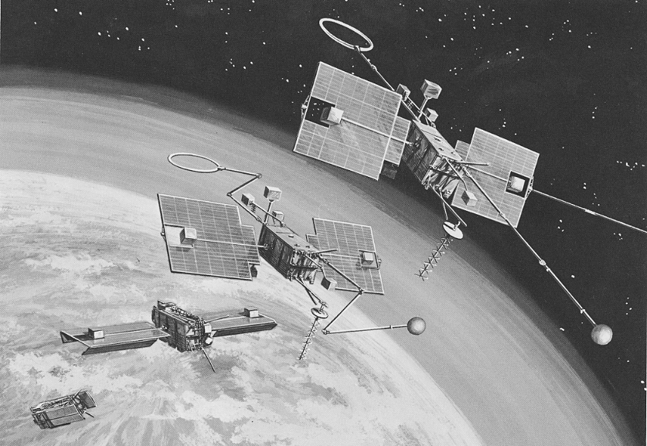
Eccentric Geophysical Observatory (EGO)
OGO 1 1964-054A Launched: 5 Sept. 1964 HEO (still in orbit)
Nominal Orbital Parameters
Semi-major Axis | Eccentricity | Inclination | Arg. Perigee
62,066 km | 0.8929 | 30.807 deg | -45.596
Burnout Conditions
Geocentric Latitude | Terrestrial Longitude | Geocentric Height | Spacecraft Velocity | Launch Azimuth | Flight Path Angle
-28.28 deg | 111.902 deg | 281.621 km | 10.645 km/s | 66.355 deg | 1.4715 deg
Notes:
From now on refer to as EGO (Eccentric Geophysical Observatory)
Using these fixed initial conditions, as stated before, the time of day launched can be altered by varying the RAAN

Slide 11
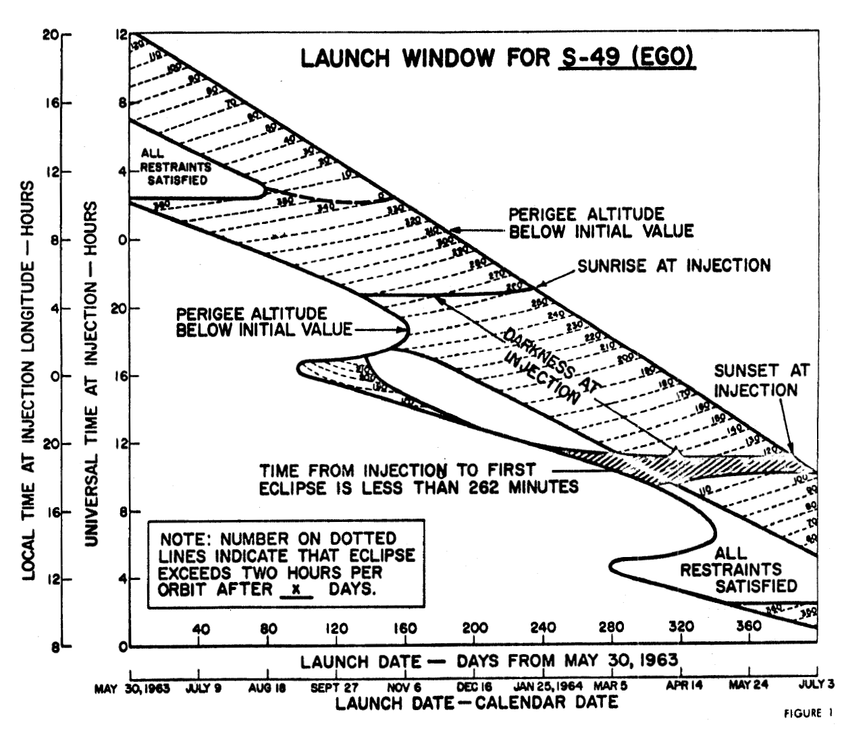
Notes:
Outline created by numerical semi-analytical Halphen method simulations to have at least a lifetime of one year
Reversals are due ti short period effects if the sun (repeats every half year)
Within this window, constraints are imposed such as time until ecliplse and darkness at injection

Slide 12
Notes:
Outline created by numerical semi-analytical Halphen method simulations to have at least a lifetime of one year
Reversals are due ti short period effects if the sun (repeats every half year)
Within this window, constraints are imposed such as time until ecliplse and darkness at injection

Slide 13
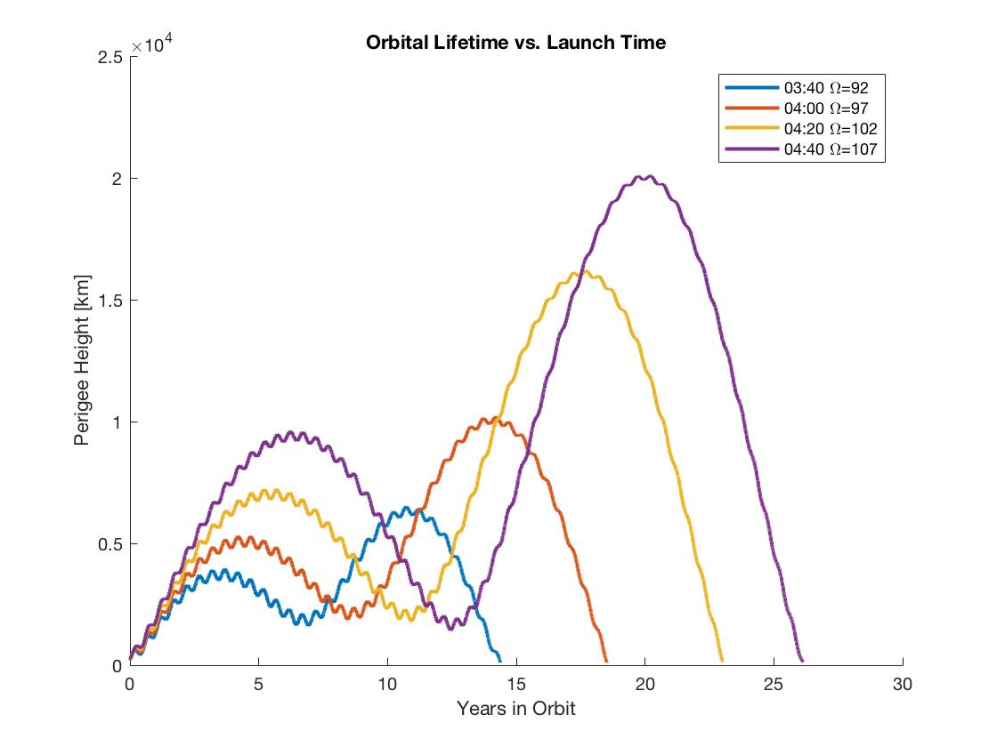
Notes:
Even just one hour in one day can produce dramtic differences in the orbital lifetime

Slide 14
Notes:
We would like to present here that lifetime estimates should be incorporated into launch window analysis
One way of doing this is to perform a similar propagations that were used to create the initial map but instead propagated forward until reentry

Slide 15
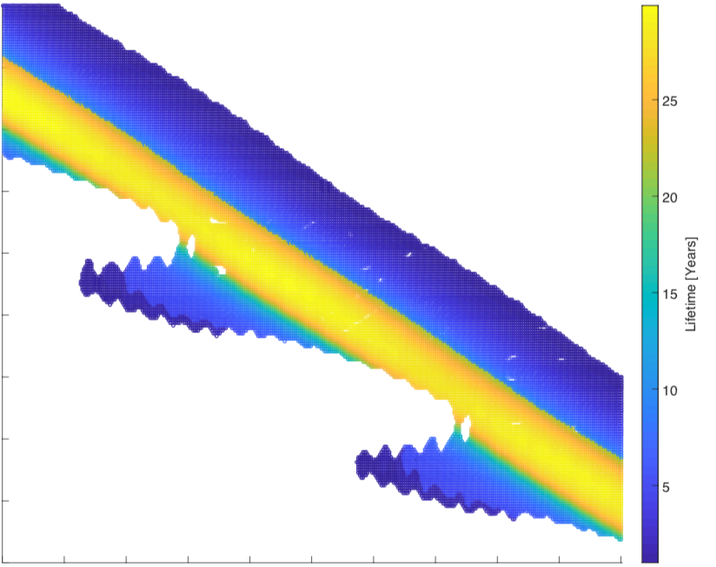
Notes:
Slight differences: semi analytical Halphen method has demise as the instantaneous perigee height where as Thalassa is radius vector going below a set limit
Smooth vs oscillations: Histroic figure is averages over the moons orbit therefore the oscillations are due ot the short period terms caused by the moon
We expect slight differences due to the higher fidelity model provided by Thalassa

Slide 16


$$0 ≈α\dot{ω}+β\dot{Ω}+γ{\dot{Ω}}_{moon}$$
$$Ψ≈αω+βΩ+γΩ_{moon}$$
Combination of resonant angles dictate the orbital lifetime
Notes:
Demonstrate why there are bands through the launch window. As RAAN decreases, the node of the moon is also changing. The combination yields a constant lifetime

Slide 17




$$0≈ α\dot{ω}+β\dot{Ω}+γ{\dot{Ω}}_{moon}$$
$$Ψ≈αω+βΩ+γΩ_{moon}$$
$$Ω$$
Combination of resonant angles dictate the orbital lifetime
Lunar nodal precession period = 18.6 years
Terrestrial nodal precession period = 24 hours
$$Ω_{moon}$$
Notes:
Demonstrate why there are bands through the launch window. As RAAN decreases, the node of the moon is also changing. The combination yields a constant lifetime
Now unfortunantly, EGO was not launched within this launch window nor with the nominal conditions

Slide 18
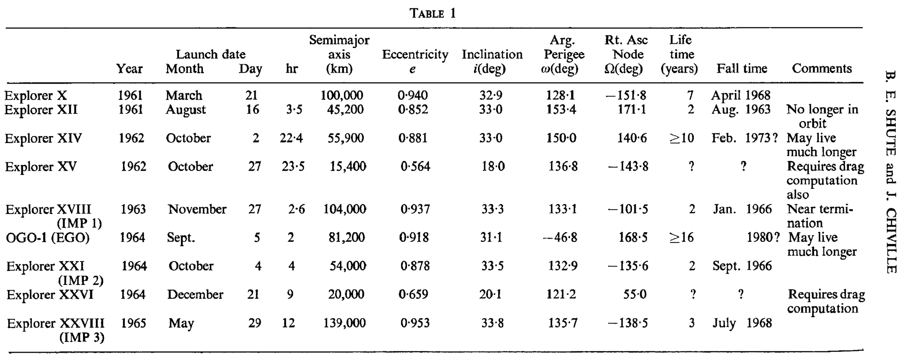
EGO Actual Launch
Shute, 1966 P&SS
Notes:
Note that the most of the conditions are the same except for the large 20,000 km increase in SMA

Slide 19

EGO Actual Launch

Slide 20
EGO Actual Launch
EGO was officially retired in 1970
  Only 6 years after launch
TLE data is sparse with a total of 12 observations from launch to retirement
  Tracking then resumed in June, 2000
  30 year gap!
Notes:
Should I just say that the TLEs were transformed?

Slide 21
EGO Actual Launch
EGO was officially retired in 1970
  Only 6 years after launch
TLE data is sparse with a total of 12 observations from launch to retirement
  Tracking then resumed in June, 2000
  30 year gap!
Propagating initial conditions provided by Shute 1966
  Follows initial TLE trajectory
  Reenters 16 years after launch
Is EGO actually still orbiting?
Notes:
Really begs to question whether or not the object being tracked 30 years later is actually the same EGO object

Slide 22
TLE Comparison Study
Questions:
  Determine if the later TLEs correspond to the trajectory before the gap (i.e. Is it the same object?)
  Would each individual TLE yield the same trajectory if analyzed separately?
  If not, can the error of the individual TLEs be quantified?
  Can launch conditions be found to recover the true trajectory?

Slide 23
TLE Comparison Study
Every observations after the gap converted to an osculating initial condition and propagated
Decay dates vary between Aug. 2020 and Feb. 2021
Begin to see convergence as observation becomes more recent
Average Decay Date: Aug 28, 2020
Ideally, each observation for an object should yield the same trajectory
  There must be “errors” in each observation

Slide 24
TLE Comparison Study
Backwards-propagate all observations to a common epoch: Nov. 10th, 1994
Able to compare the distribution of orbital elements resulting from each observation
Notes:
Outliers thrown out of data
Take out the outlier

Slide 25
TLE Comparison Study
Backwards-propagate all observations to a common epoch: Nov. 10th, 1994
Able to compare the distribution of orbital elements resulting from each observation
Notes:
Outliers thrown out of data
Add

Slide 26
TLE Comparison Study
Backwards-propagate all observations to a common epoch: Nov. 10th, 1994
Able to compare the distribution of orbital elements resulting from each observation
Used these mean values as the new initial conditions
Distribution of Orbital Elements
Semi-major axis | Eccentricity | Inclination | RAAN | Arg. Perigee
559.61 km | 0.0621 | 9.613 deg | 43.003 deg | 44.889 deg
80814.37 km | 0.8597 | 20.351 deg | 201.876 deg | 290.143 deg
Range
Mean
Notes:
Outliers thrown out of data
Add

Slide 27
TLE Comparison Study
Initial conditions used for backward-propagation to actual launch epoch: 01:23 Sept. 5th 1964
Obtained a new set of “launch conditions”
Launch Epoch Orbital Elements
SMA | ECC | INC | RAAN | AOP
80,841 km | 0.9138 | 32.05 deg | 166.68 deg | 315.483 deg
Notes:
These conditions are not very different from the nominal conditions

Slide 28
TLE Comparison Study
New set of launch conditions propagated forward
Notes:
Outliers thrown out of data

Slide 29
TLE Comparison Study
New set of launch conditions propagated forward
Trajectory fully recovered!
The observations after the gap correspond to the correct object!
Current prediction of demise Sept. 13th 2020
Can now create the launch window map for the actual launch!
Notes:
Outliers thrown out of data

Slide 31
Notes:
Ideally we would want to superimpose other constraints onto this map and choose a launch date/time so we avoid choosing a launch time that would yield a large lifetime

Slide 33
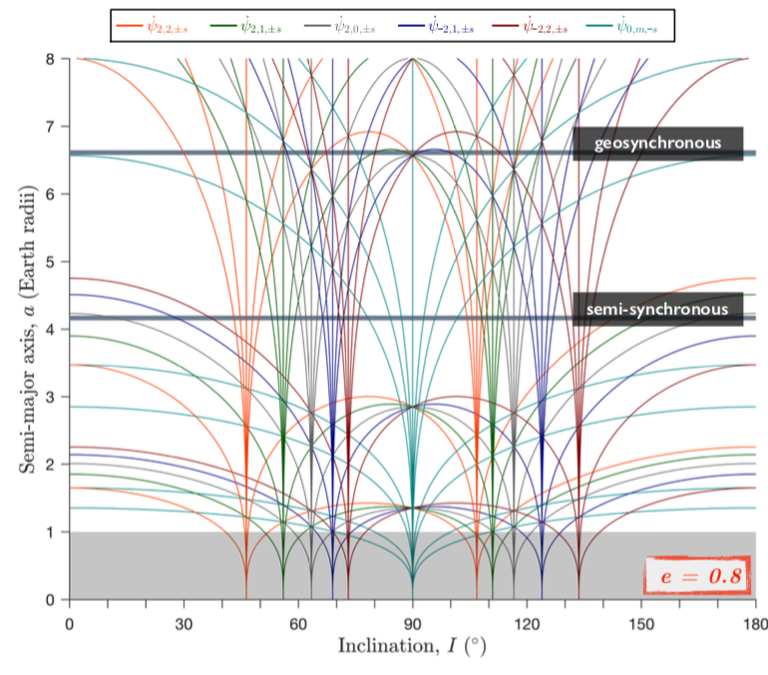
Future Work
Derive averaged equations that govern HEO resonances
Create “resonance web” to accurately portray resonances occurring at large semi-major axis and eccentricity
  Will be able to determine which resonances will effect certain objects
Apply launch window analysis to INTEGRAL satellite to see if use of maneuvers could have been avoided

Slide 34
Takeaway
Lunisolar perturbations can dramatically influence the lifetime of highly eccentric orbits
Lifetime of an object is highly sensitive to not only the date of launch but also the time of launch
Lifetime estimates should be implemented as a constraint during the mission planning phase to ensure predictable behavior and compliance with mitigation guidelines
A deep understanding of naturally occurring resonances could potentially eliminate the need for costly end of life maneuvers (i.e. INTEGRAL)

Slide 35
Questions?

